Slide 1
Group 14

Slide 2

Group 14 elements all have 4 valence electrons. This means they all tend to form 4 covalent bonds (share 4 electrons with other non-metals).
Group 14 elements have a wide range of properties and uses, as the group has 1 non-metal (carbon, C), 2 metalloids (silicon, Si, and germanium, Ge) and 2 metals (tin, Sn, and lead, Pb).

Slide 3
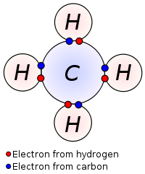
As a reminder, covalent bonding occurs when an atom shares its valence electrons. Group 14 elements have 4 valence electrons, and can share them to form 4 covalent bonds.
This is the most covalent bonds an element can form, aside from a few complex exceptions.
Note, this picture does not show carbon's inner electron shell.

Slide 4
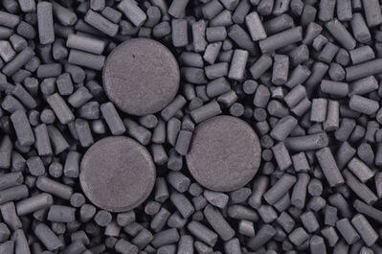
Carbon really steals the spotlight in group 14.
Pure carbon can exist in several different forms, all with a huge range of properties, and carbon compounds make up all known life on Earth.

Slide 5
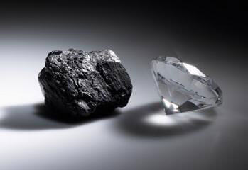
Carbon exists in several different forms (known as allotropes), the two most common are graphite and diamond. These forms have very different properties.
Graphite is black, soft and conducts electricity.
Diamond is clear, hard and does not conduct electricity.

Slide 6

Watch this video (0:57) for a few examples of the range of properties carbon has.

Slide 7

Silicon is the next element in group 14.
Silicon is the main component in glass, and is used to produce a variety of electronics.
Due to silicon sharing many properties with carbon, it could theoretically be a building block for life on other planets!

Slide 8
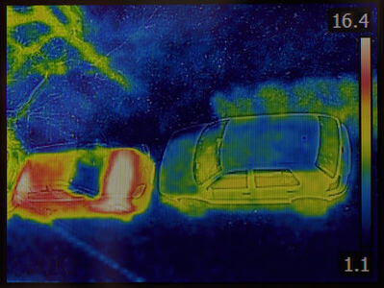
Germanium is the third element in group 14.
Germanium is also used to produce glass and electronics, however, it tends to be used for more specialised applications, such as thermal vision cameras.

Slide 9
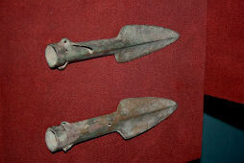
Tin is the fourth element in group 14.
Tin is a metal which has been used for thousands of years, as a component of bronze.
Tin is also a component of brass, pewter and solder.

Slide 10

Lead is the fifth element in group 14, and the last that exists naturally.
Before it was known to be poisonous, lead was used for plumbing and paints. Nowadays, 80% of all lead produced is used to make car batteries.
Contrary to popular belief, lead metal has never been used to make pencils!

